Slide 1



New Frontiers in Research Fund
Exploration Stream Workshop
Moderator and Program Overview: Kristina Rissling Olson, RASI
Panelist Discussion
Dr. Mark Fenton, Associate Professor
Division Head, Respirology, Critical Care and Sleep Medicine
Dr. Michael Levin, Professor of Neurology and Anatomy & Cell Biology
Saskatchewan Multiple Sclerosis Clinical Research Chair
July 13, 2022

Slide 2
NFRF Exploration Overview
The goal of Exploration is to inspire high-risk, high-reward and interdisciplinary research.
Up to $125,000/year for up to 2 years
Proposals must be submitted by research teams composed of at least two individuals.
The proposed project must combine elements from at least two different disciplines with goal of bringing novel disciplines together.

Slide 3
NFRF Exploration Timelines
Competition Deadlines:
  NOI Deadline: June 28th
  Full Application Deadline: September 13th
  All submissions must be done through the Convergence Portal.
Internal Review Process Deadlines:
  Draft Application to RASI: August 10th
  Completed reviews returned to Applicant: August 19th
  RASI Compliance Review and Approval: September 6th

Slide 4
NFRF Exploration Internal Review
Internal Review
  Asking those who submitted an NOI if they want to participate in internal review
  Reviewers will be assigned by RASI
  Reviewer will have been a national reviewer or have been awarded an Exploration
  Email Kristina.risslingolson@usask.ca to take part in Internal Review

Slide 5
NFRF Selection Criteria
Five selection criteria:
  Interdisciplinary
  Equity, Diversity and Inclusion
  High Risk
  High Reward
  Feasibility
See “2022 Exploration: Merit Indicators for the Review Process”: Merit Indicators for the Review Process (sshrc-crsh.gc.ca)
Notes:
High-risk defined (from Reviewer manual):
challenging current research perspectives or paradigms;
using equipment, techniques or approaches proven or assumed to be extraordinarily difficult;
bringing together an unprecedented combination of disciplines with different perspectives;
viewing the project from an unfamiliar interdisciplinary perspective, to use novel approaches to solve existing problems;
other risks (indicate each one in a text box); and
no risks.
High Reward:

Slide 6
NFRF Webinar
NFRF is hosting a webinar tomorrow on the full application stage
Will be presented on Teams from 11am-1pm
Will be recorded and sent out along with the slides
  Kristina will forward them once received
Kristina sent out an email this morning with the new details
Notes:
High-risk defined (from Reviewer manual):
challenging current research perspectives or paradigms;
using equipment, techniques or approaches proven or assumed to be extraordinarily difficult;
bringing together an unprecedented combination of disciplines with different perspectives;
viewing the project from an unfamiliar interdisciplinary perspective, to use novel approaches to solve existing problems;
other risks (indicate each one in a text box); and
no risks.
High Reward:

Slide 7
Usask Submissions and Results
Exploration | USask |  |  | National
Year | Applications | Awarded | Success Rate | Applications | Awarded | Success Rate
2018 (ERCs only) | 43 | 5 | 11.6% | 1,315 | 157 | 11%
2019 | 4 | 1 | 25.0% | 907 | 186 | 20%
2020 | 19 | 3 | 15.8% | 607 | 117 | 19.3%
2021 | 9 | 3 | 33.3% | N/A | 102 | N/A

Slide 8
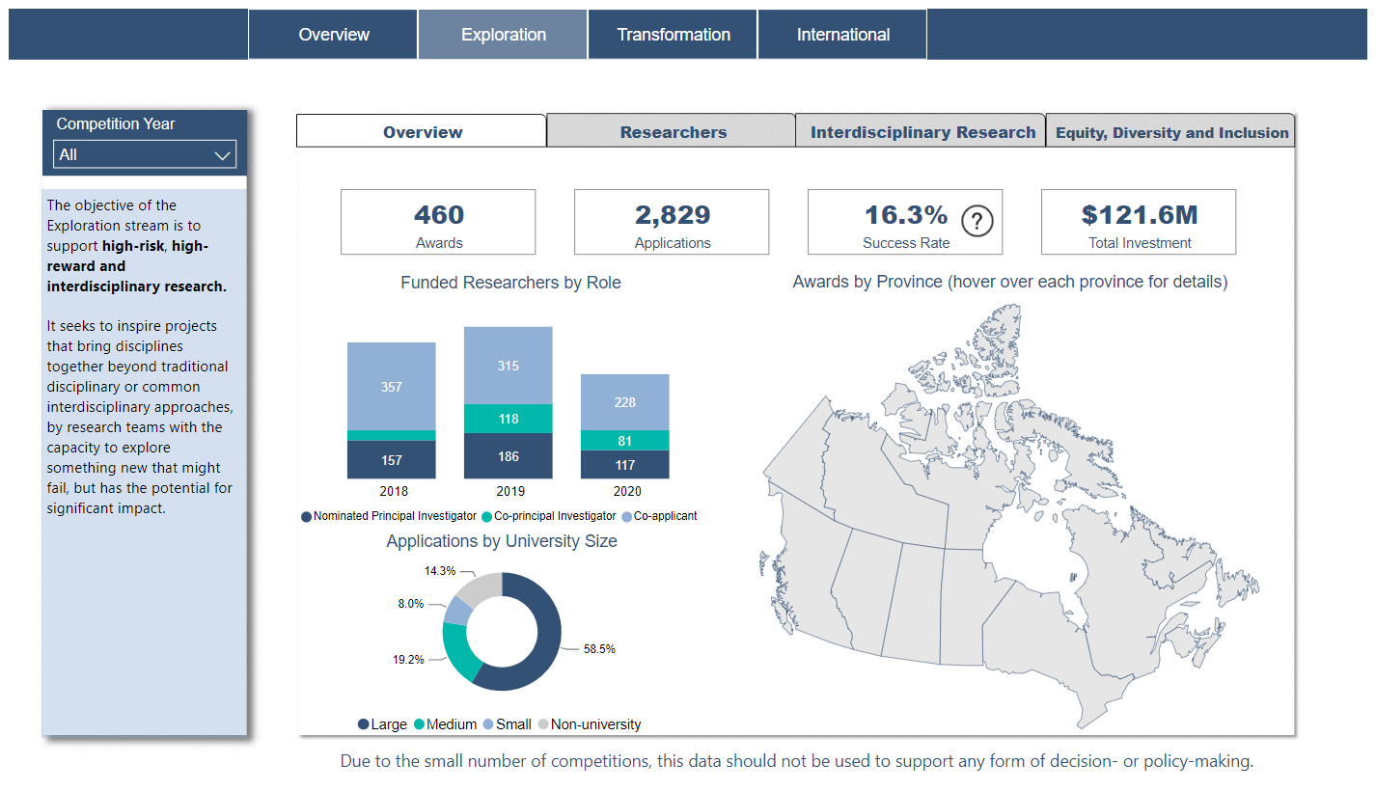
National Statistics - Exploration Stream
*Note: Data can be found at https://app.powerbi.com/view?r=eyJrIjoiNzczYTMxMjUtNDUxMS00N2ZmLTg5MjQtNmZlNzEyMmM2ZjMzIiwidCI6ImZiZWYwNzk4LTIwZTMtNGJlNy1iZGM4LTM3MjAzMjYxMGY2NSJ9&language=en-ca

Slide 9
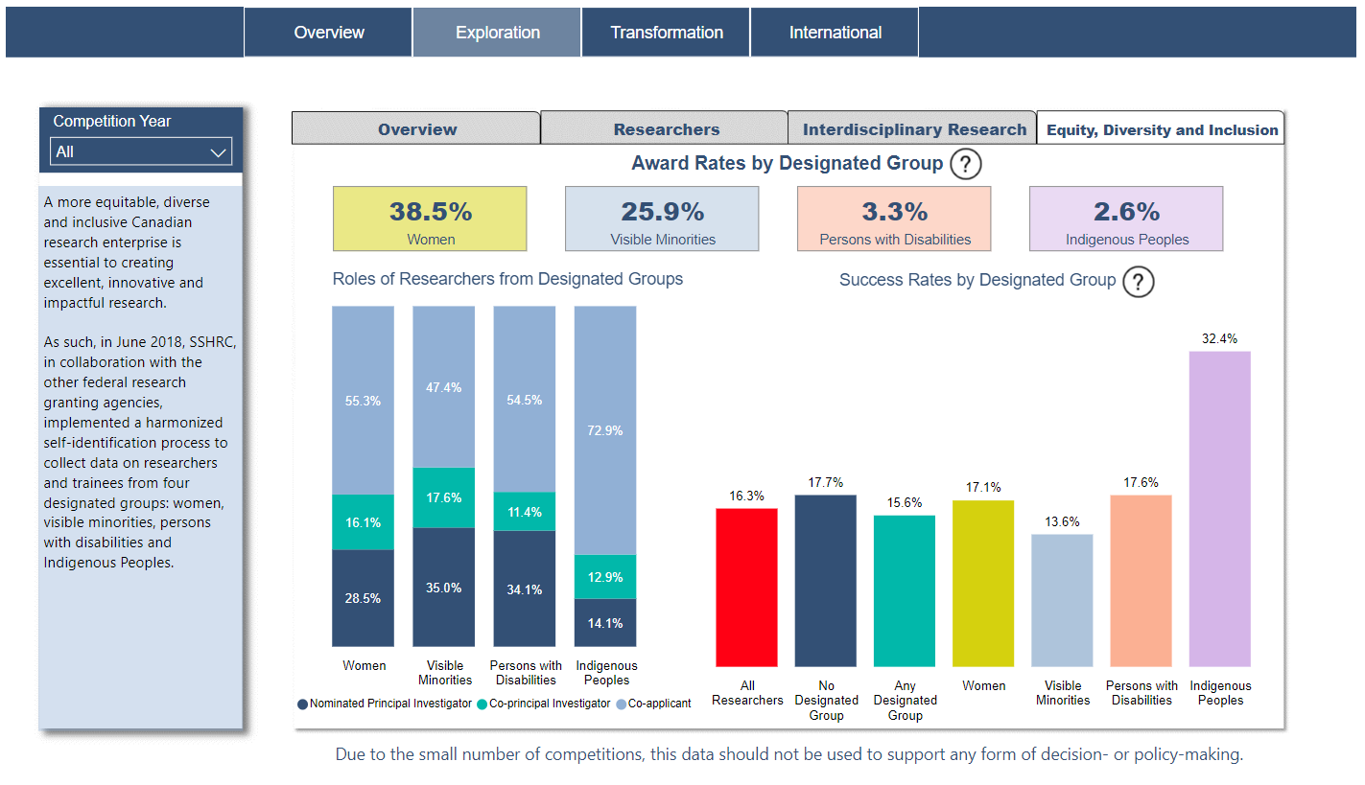
National Statistics - Exploration Stream

Slide 10
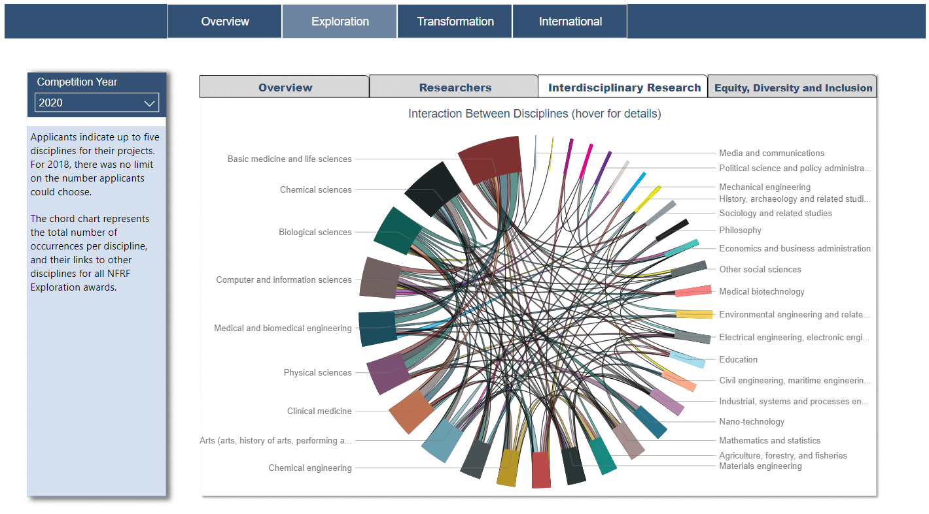
National Statistics - Exploration Stream

